Slide 1
Routing

Slide 2
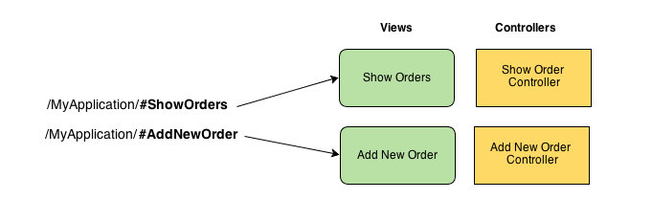
Routing helps you in dividing your application in logical views and bind different views to Controllers.

Slide 3
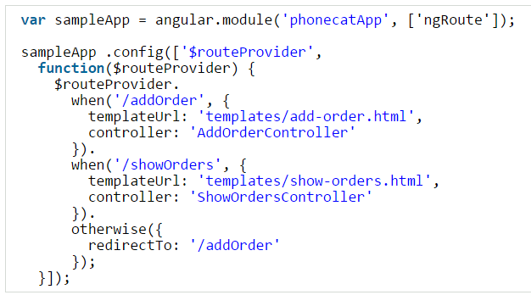
Introduction to $routeProvider
Application routes in Angular are declared via the $routeProvider, which is the provider of the $route service. This service makes it easy to wire together controllers, view templates, and the current URL location in the browser. Using this feature we can implement deep linking, which lets us utilize the browser’s history (back and forward navigation) and bookmarks.
Syntax to add Routing
Once we have our app, we can useconfig() method to configure $routeProvider. $routeProvider provides method .when() and.otherwise() which we can use to define the routing for our app.

Slide 4
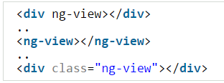
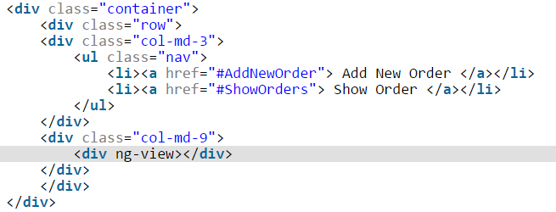
ng-view
One thing worth noting is the ng-view directive. In our angular app, we need to define ng-view directive once. This becomes the placeholder for views. Each view referred by the route is loaded in this section of document.
You can define ng-view in main html file in one of the below way.
-------------------------------------------------------------------------------------------------------------------

Slide 5
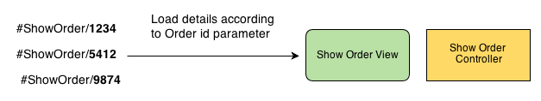
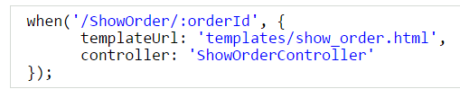

2. How to pass Parameters in Route Urls
Consider below scenario. We want to display details of different orders. Based on a parameter order_id we will define order details in view.
In angular while define route we can define parameters using orderId in url. For example:
And we can read the parameter in Controller by using $routeParams.orderId.

Slide 6
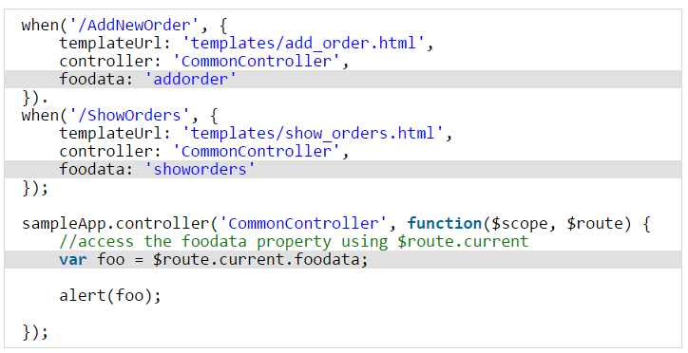
3. Add Custom Data to RouteProvider
The $routeProvider provides methods when() and otherwise() which we used to define url routes. Sometime we might want to pass custom data based on certain route. For example you might use same Controller in different routes and use some custom data. For example:

Slide 7
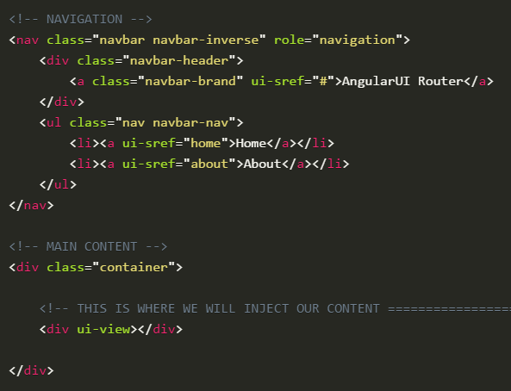
What is AngularUI Router?
The UI-Router is a routing framework for AngularJS built by the AngularUI team. It provides a different approach than ngRoute in that it changes your application views based on state of the application and not just the route URL.
States vs URL Route
With this approach, your views and routes aren’t tied down to the site URL. This way, you can change the parts of your site using your routing even if the URL does not change.
When using ngRoute, you’d have to use ngInclude or ng-view and this could get confusing. Now that all of your states, routing, and views are handled in your one .config(), this would help when using a top-down view of your application.

Slide 8
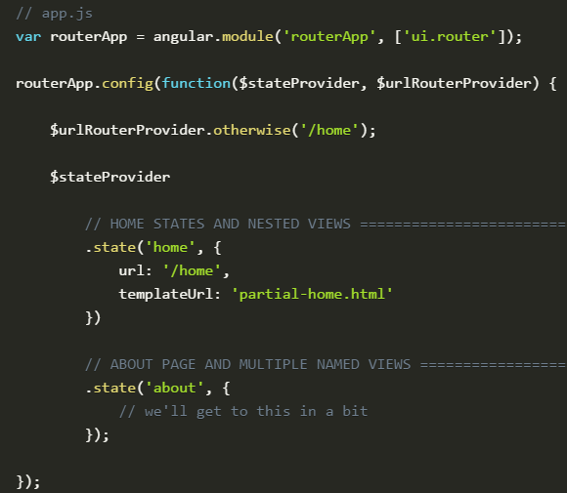
When creating a link with UI-Router, you will use ui-sref. The href will be generated from this and you want this to point to a certain state of your application. These are created in your app.js.
We also use <div ui-view></div> instead of ngRoute’s <div ng-view></div>.

Slide 9
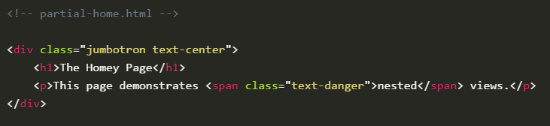
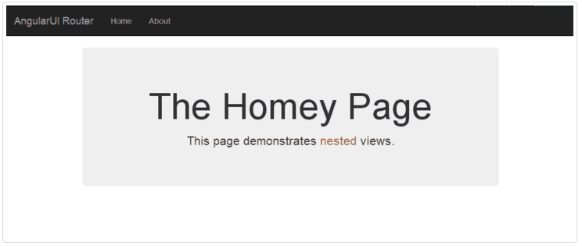
Now we have created the routerApp that we already applied to our body in theindex.html file.
Here we have a .state() for home and for about. In home, we are using the template file partial-home.html.
Let’s fill out our partial-home.html page so we can actually see information.

Slide 10
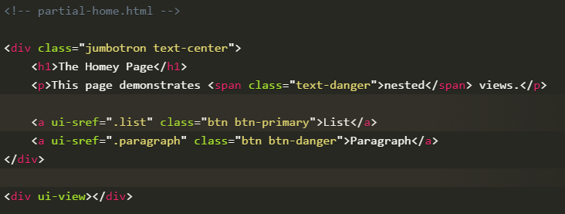
Nested Views
When linking to a nested view, we are going to use dot denotation:
ui-sref=".list" and ui-sref=".paragraph".
These will be defined in our Angular file and once we set it up there, we will inject into our new <div ui-view></div>.

Slide 11
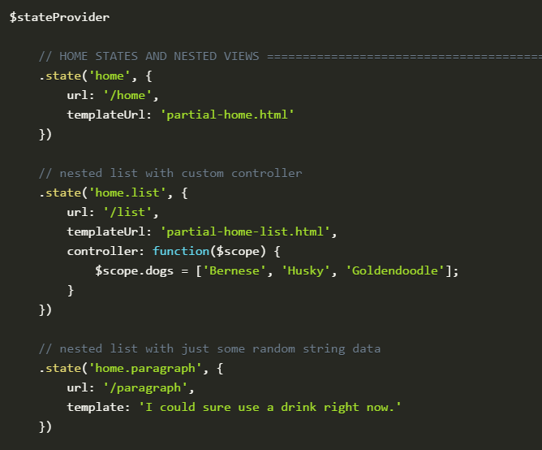
In our app.js file, let’s create those nested states.

Slide 12
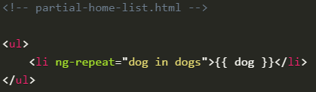
Now the ui-sref we defined in home.html are linked to an actual state. Withhome.list and home.paragraph created, those links will now take the template provided and inject it into ui-view.

Slide 13
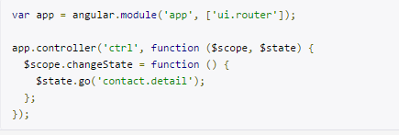
Manually moving to other states
$state.go(to, params)
While configuring states
.state(‘stateName’,{
templateUrl:’url’,
controller:’controllerName’,
params:{parName:null}
})
Using in your controller
$scope.abc=$state.params.parName;
Sending values from controller to other controller
$state.go(‘stateName’,{parName:’Rohan’})

